Slide 1

Prepared by group 6
Unveiling Gender Inequality
In Work space environment

Slide 2
Goal - 5
Gender inequality continues to be a critical issue affecting societies worldwide. This presentation explores key aspects of gender inequality through insights collected from survey responses. By examining the experiences and perspectives shared, we aim to deepen our understanding of the challenges and identify actionable steps toward creating a more equitable future for all.

Slide 3

Problem Identification
Gender Disparities in the Workplace
Gender disparities in the workplace persist, with women facing wage gaps, underrepresentation in leadership roles, and systemic barriers that hinder their professional growth.
Justification:
Addressing these disparities is essential for economic growth, as gender equality in the workplace leads to diverse perspectives, improved decision-making, and enhanced organizational performance.

Slide 4




Problem Statement
Despite progress in gender equality, significant workplace disparities remain, hindering women's access to equal opportunities, fair pay, and career advancement. Women are underrepresented in leadership roles, face wage gaps, and encounter systemic barriers that limit their professional growth.
Problem
Gender disparities in the workplace result in wage gaps and underrepresentation of women in leadership roles.
Justification
Addressing these issues is crucial for economic growth and improved organizational performance.
Work-Life Balance Challenges
Women are disproportionately responsible for unpaid care work, which can limit their availability for full-time employment or career advancement.

Slide 5

Current scenario
Economic Inequality
Women earn less than men and face barriers to higher-paying roles, particularly in leadership and STEM.
Political Representation
Cultural norms and stereotypes restrict women's opportunities and freedoms, leading to discrimination and unequal domestic responsibilities.
Social Norms and Stereotypes
Women are underrepresented in politics, affecting policies on healthcare, childcare, and workplace rights.

Slide 6



Survey Based Observation
Workplace Policies
Leadership Career
Equal access to mentorship opportunities across genders
Experience with gender sensitivity and unconscious bias training
Impact of gender on career advancement opportunities
Personal experience with gender-based job/promotion denial
Workplace Discrimination
Comfort level in reporting gender discrimination incidents
Frequency of witnessed gender discrimination

Slide 7

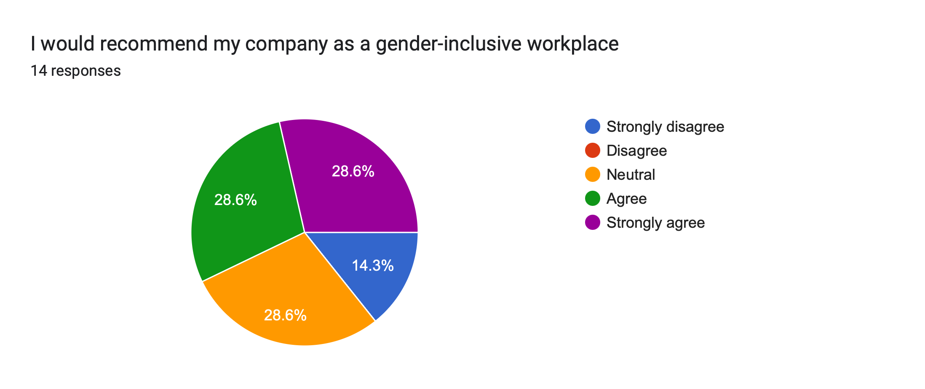
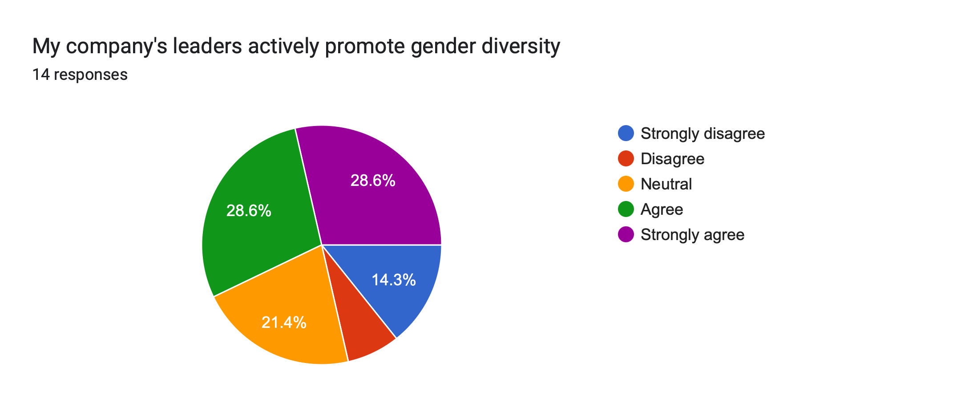
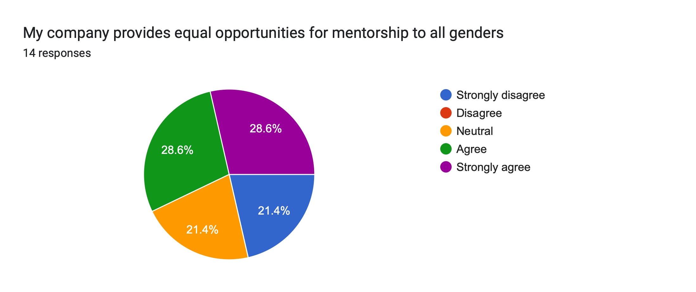
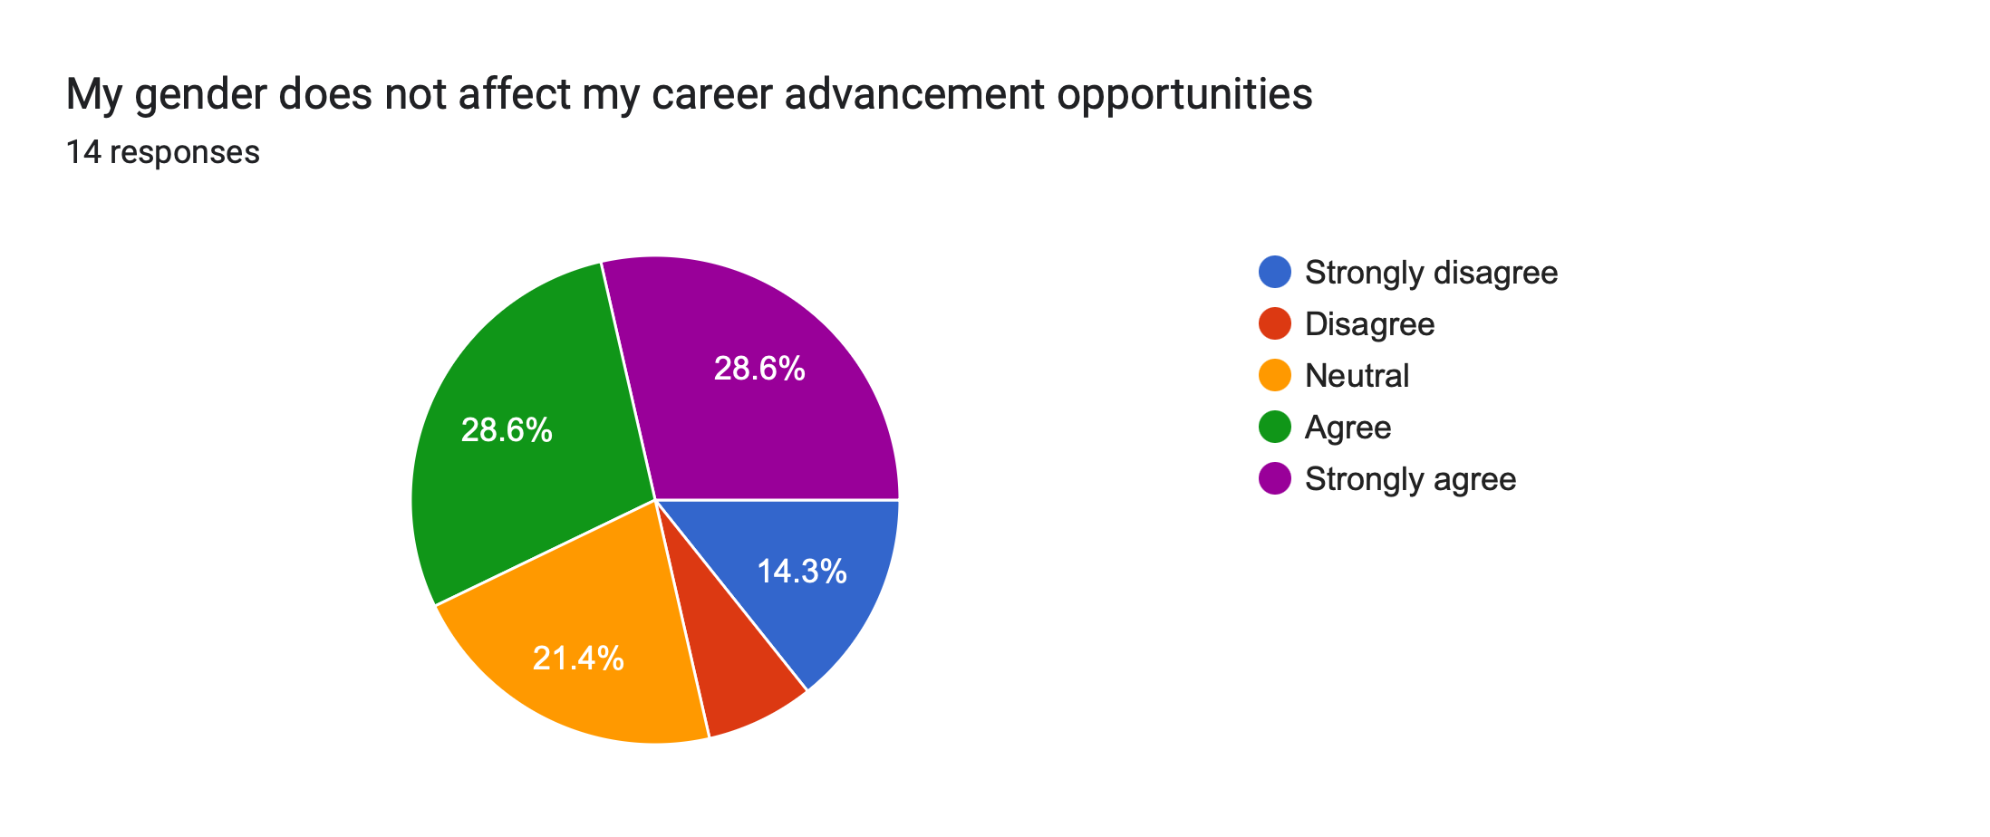
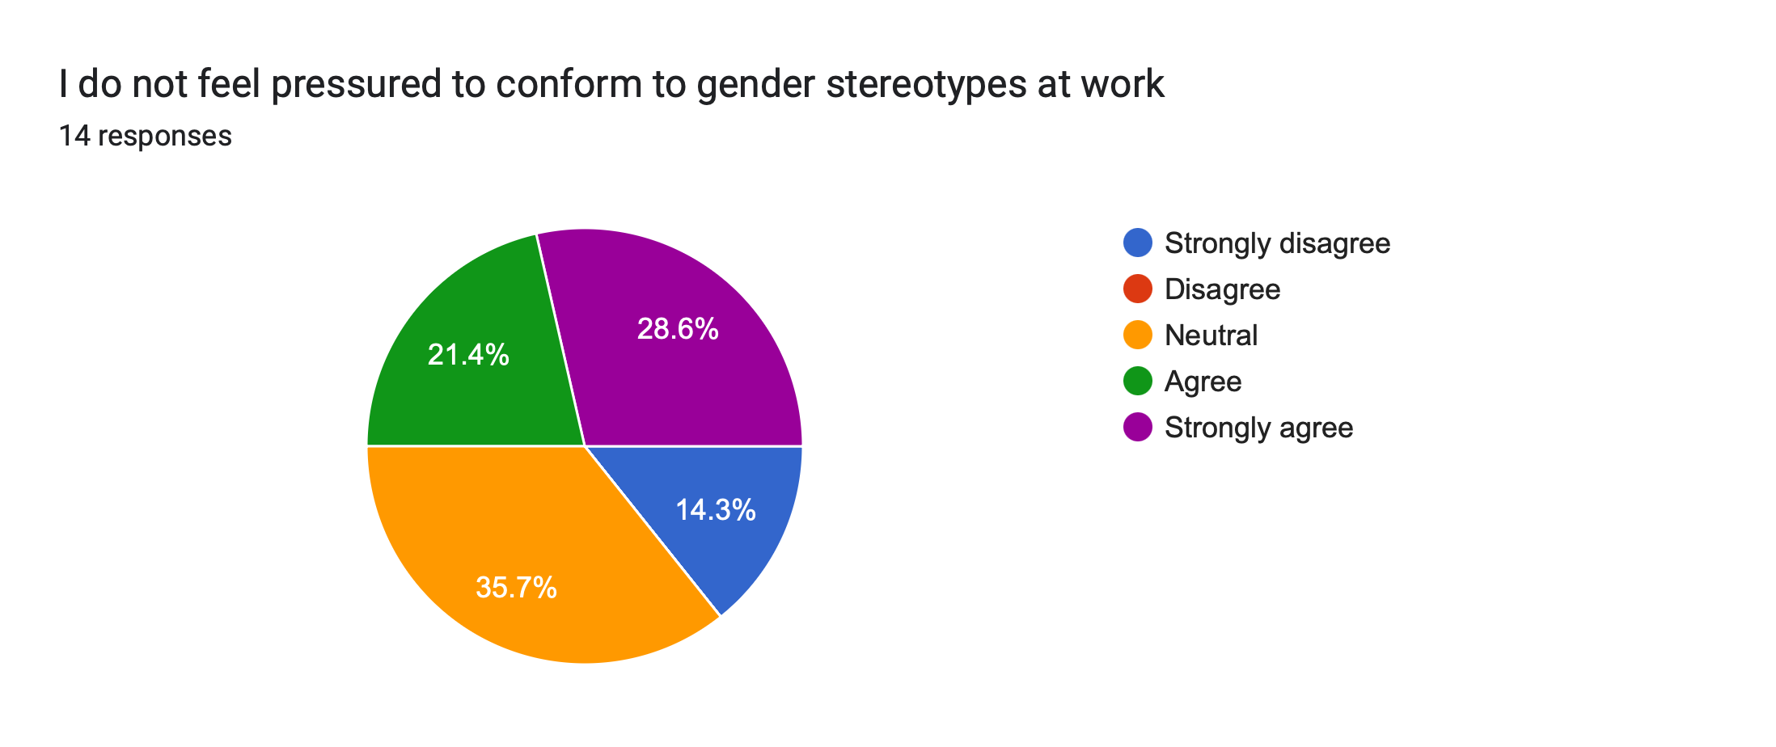
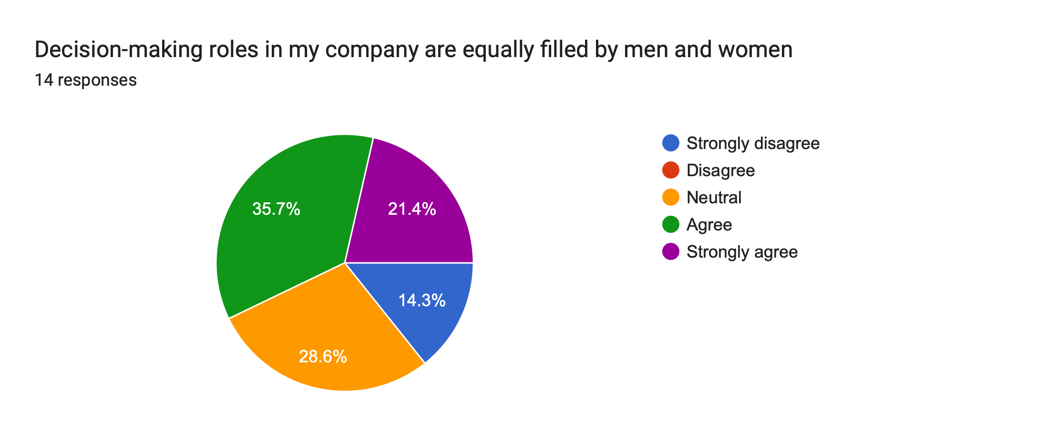
Methodology
Data Collection:

Slide 8
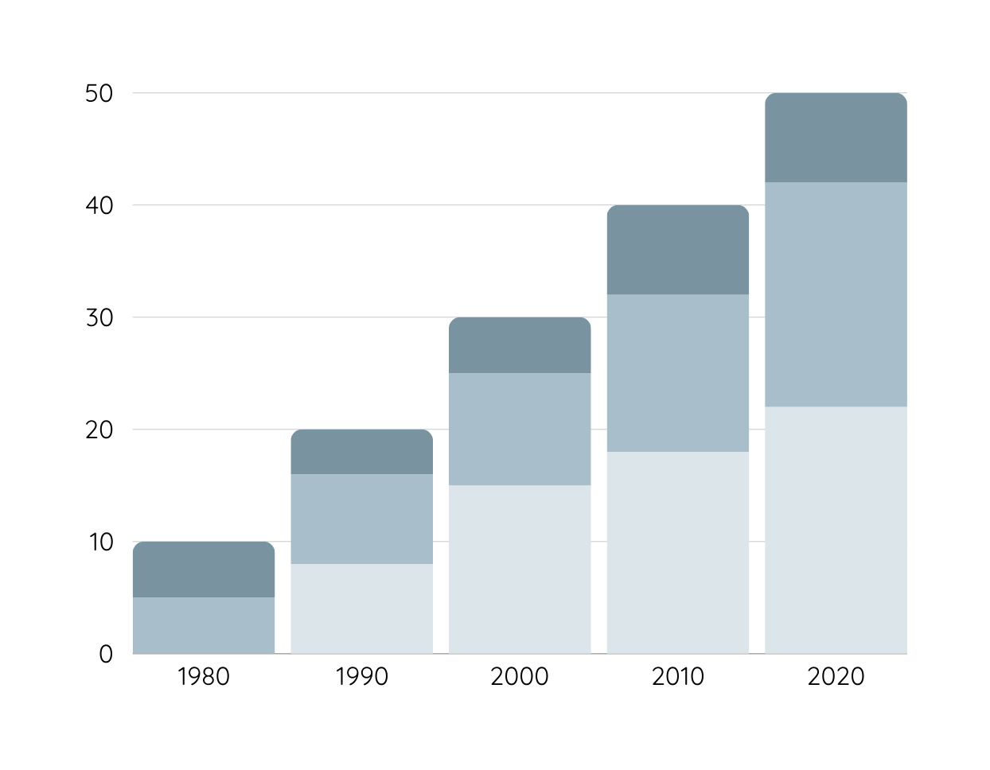
Data Analysis
The cultural landscape of organizations demonstrates concerning patterns in gender-based discrimination and inclusivity. Reporting mechanisms for discrimination incidents,
Workplace Discrimination
Leadership Career
Workplace Discrimination

Slide 9
Conclusion
Sustainable Development Goal 5 (SDG 5) aims to achieve gender equality and empower all women and girls. It focuses on ending discrimination, violence, and harmful practices against women, ensuring equal rights to economic resources, and promoting their full participation in leadership and decision-making. Gender equality is essential for sustainable development and is linked to various other SDGs.

Slide 10
Team Members
Marcia Sherin
Rithika
Member
(RA2211003050174)
Member
(RA2211003050169)
Raghu
Member
(RA2211003050165)

Slide 11
Thank you

